Slide 1

Welcome to
Cloud Computing for Data Analysis
DSBA 6190-U90 | Fall 2024
Colby T. Ford, Ph.D.

Slide 2

Welcome to Cloud Computing for Data Analysis
DSBA 6190-U90 | Colby T. Ford, Ph.D.

Slide 3
Overview
About Me
About You
Intro Survey
About this Course
Topics to Cover
Grading and Assignments
Other Stuff…
Getting Started
Installation of Req’d Software
Getting Logged In

Slide 4
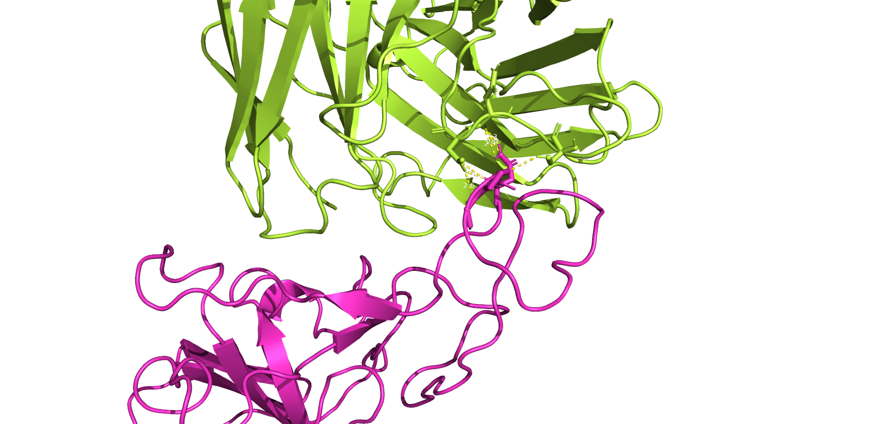
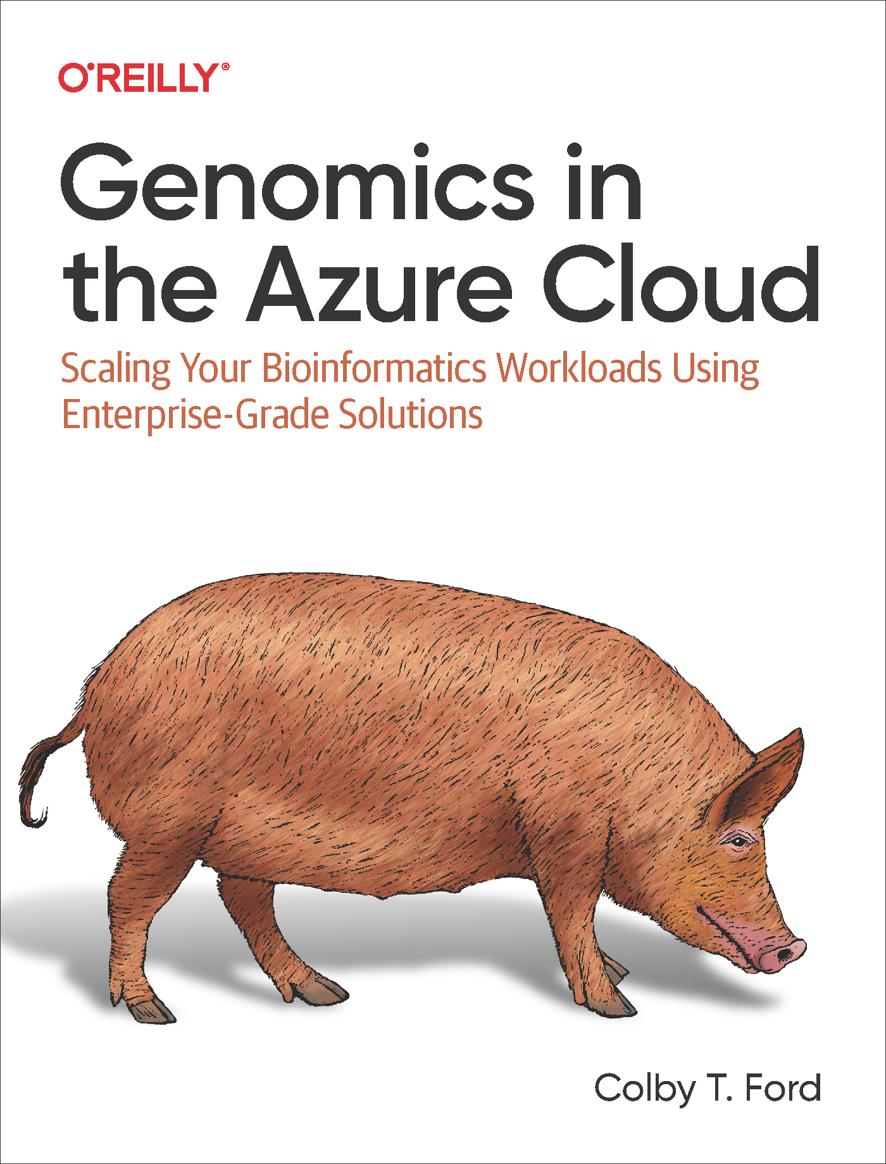




About Me
Colby T. Ford, Ph.D.
Computational Biologist and Cloud AI Architect
Founder, Principal Consultant
tuple.xyz
Co-Founder, VP of Technology
amissa.com
Associate Faculty / Visiting Scholar
School of Data Science / CIPHER
sds.charlotte.edu / cipher.charlotte.edu
AzureGenomics.com
Research Interests:
Infectious diseases (SARS-CoV-2, Plasmodium sp., E. coli)
Human genomics (Oncology, rare diseases, etc.)
Protein structure design (mAbs, HLA-TCR, etc.)
Scalable cloud architectures, bioinformatics pipelines, bioAI

Slide 5
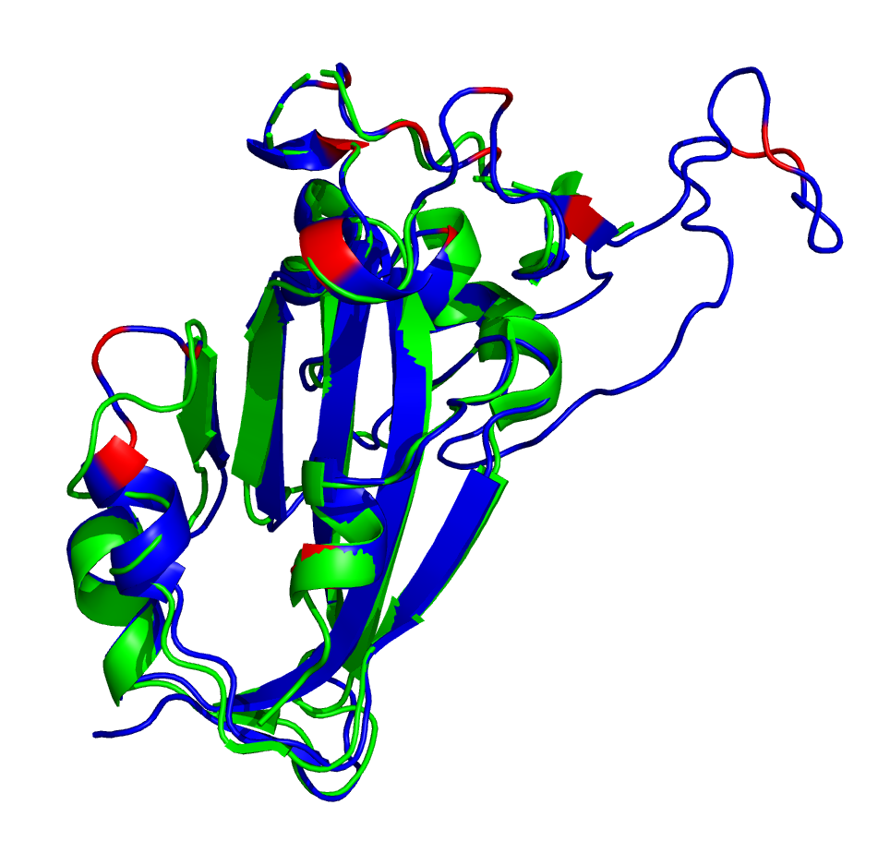
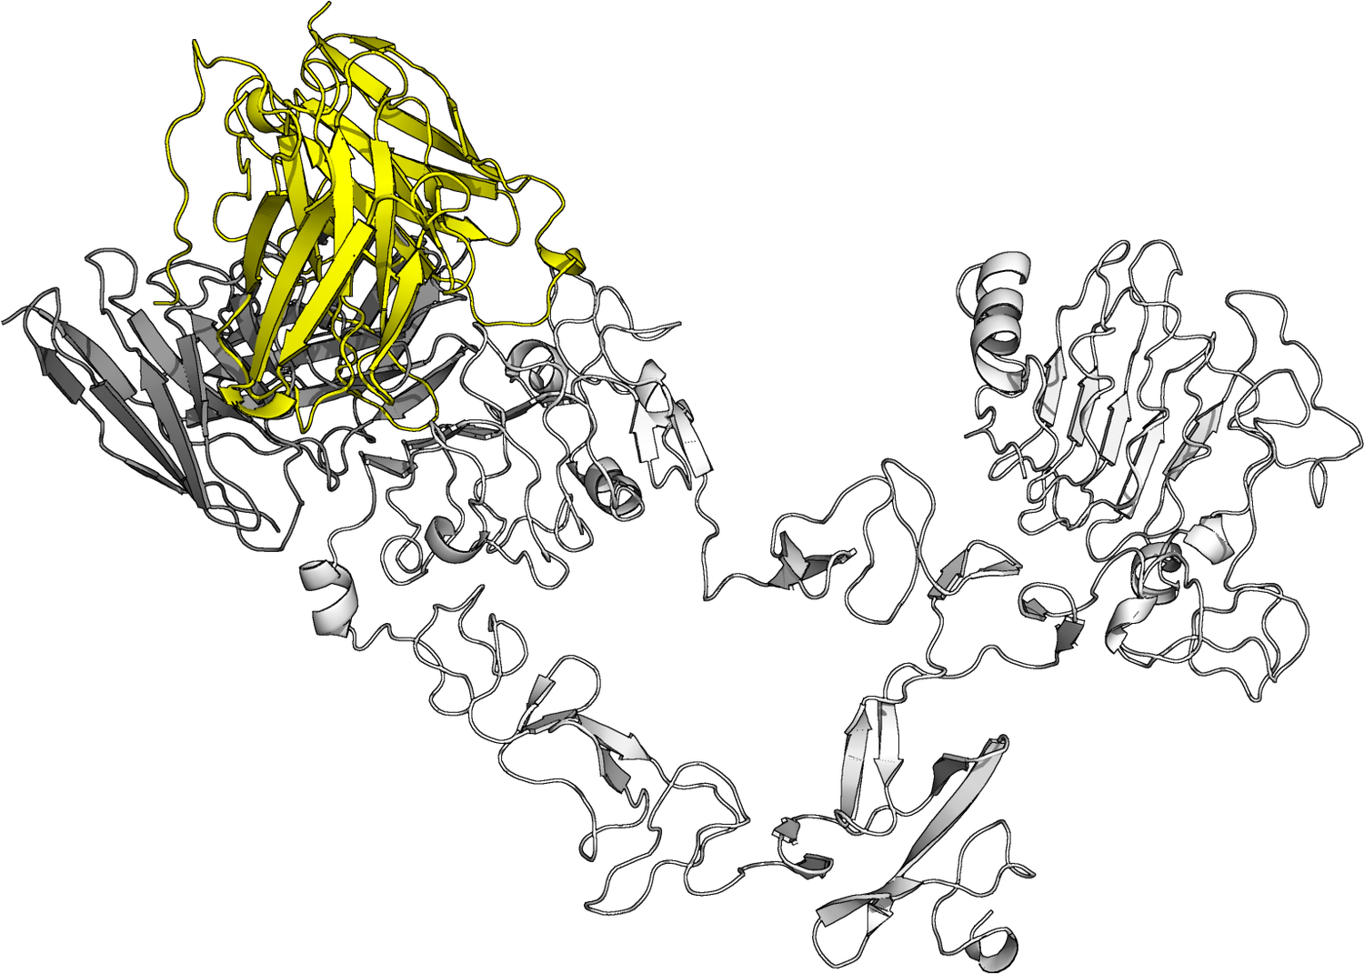
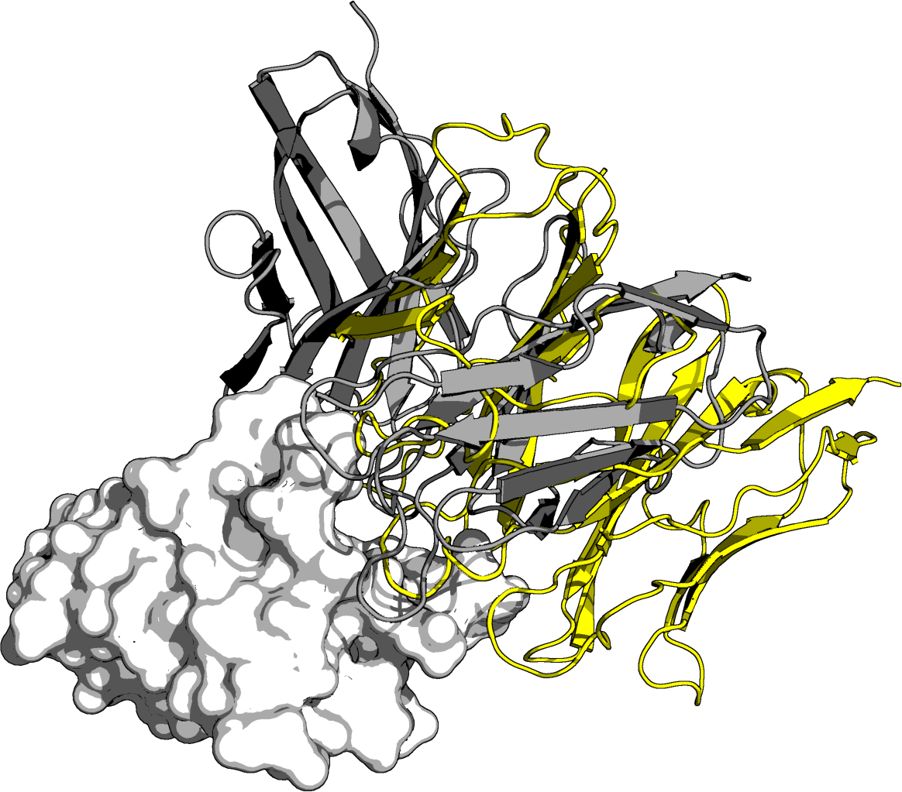
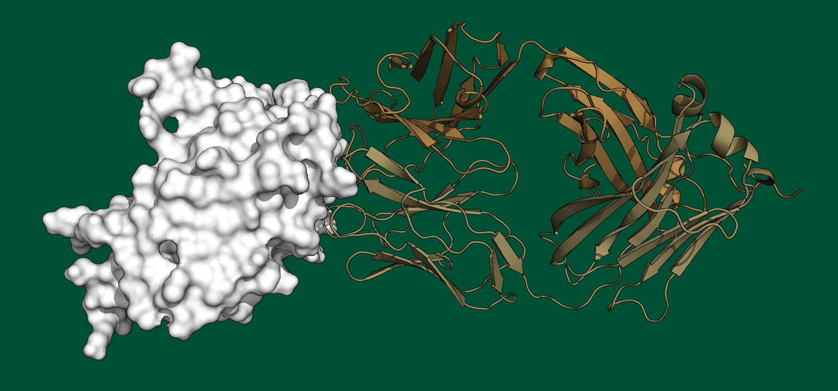
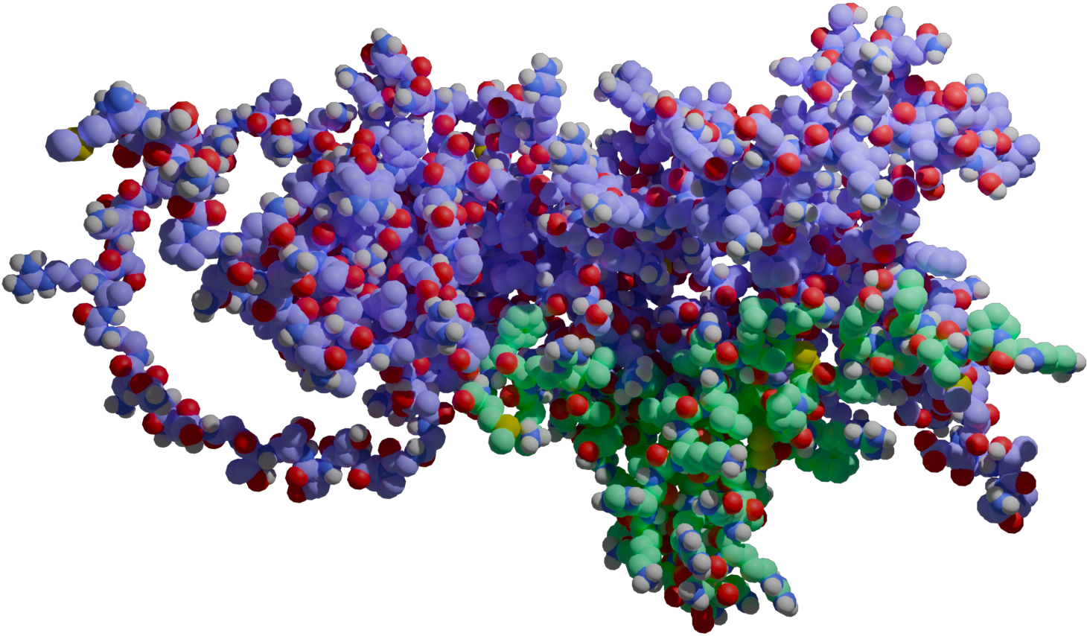
AI-derived
anti-PD-1 antibody
AI-derived
anti-EGFR antibody
SARS-CoV-2 Omicron S prediction
(Ford et al., 2022)
H5 influenza HA1 w/ AVFluIg03 antibody
(Ford, 2024)
SARS-CoV-2 WA1 N w/ CXCL12β cytokine
(Ford et al., 2024)
My Research (lots of proteins)
(Tomeszko and Ford et al., 2024)

Slide 6






About Me
Email: colby.ford@uncc.edu
Office: PORTAL 354A
(Can meet by appt.)
Research Interests
Biology:
Human Genomics
Oncology, Rare Diseases
Infectious Diseases
SARS-CoV-2, E. coli, Malaria
Protein Analysis
Immunoproteins (mAbs, HLA, TCR)
Computer Science:
Scalable Computing
Machine Learning
Sr. Bioinformatics Cloud Engineer
Manager, Machine Learning
Co-Founder, V.P. Of Technology
Founder, Principal Consultant
Associate Faculty, SDS
University Business Partner
B.A. – Applied Mathematics
M.S. – Data Science
Ph.D. – Bioinformatics and Computational Biology
INTJ

Slide 7





























Slide 8
About You
Course Website
We will use Canvas…kinda
https://sites.google.com/uncc.edu/dsba6190
Take the Intro Survey
Navigate to the Introduction page and click on the Take the Intro Survey! button

Slide 9
About this Course

Slide 10
Who’s your TA??!? Paige Oldiges Email: poldiges@uncc.edu

Slide 11










Topics to Cover
Data Platform
Databases, Data Warehouses
Data Lakes and Data Stores
Machine Learning
ML Algorithms
Cognitive Services
Tuning and CV
Automated ML
Neural Networks
MLOps/Operationalization
Distributed Computing
Kubernetes and Docker
Apache Spark and Databricks
MPI and Snow
DevOps and Security
Resource Deployment with Terraform
CI/CD Pipelines in GitHub Actions
RBAC, ACLs, and AAD
Security and Compliance Considerations
Azure

Slide 12
Data Platform
ITCS/DSBA 6160 – Database Systems
Parallel Computing
ITCS 5145 – Parallel Computing
Deep Learning
ITCS 5111 – Intro to Natural Language Processing
Machine Learning
ITCS 6156 – Machine Learning
DSBA 6156 – Applied Machine Learning
ITCS 6162 – Knowledge Discovery in Databases
ITCS 6163 – Data Warehousing
BINF 6210 – Machine Learning for Bioinformatics
ITCS 5152 – Intro to Computer Vision
ITCS 6216 – Intro to Cognitive Science
BINF 6211 – Design & Implementation of Databases
…Plus a bunch of business analytics classes
ITCS 6150 – Intelligent Systems

Slide 13
Disclaimer: This course is actively being updated as we go. Be flexible and I’ll return the favor. ☺

Slide 14
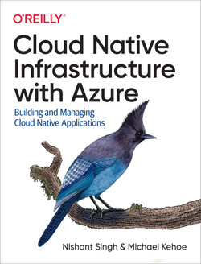
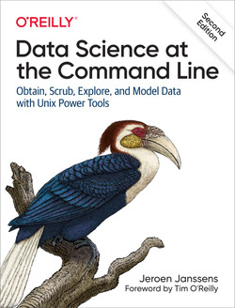
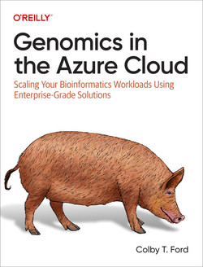
No Required Course Materials
If you just love books:
Cloud Native Infrastructure with Azure by Singh and Kehoe
Data Science at the Command Line by Janssens
Genomics in the Azure Cloud by yours truly
Documentation and slides will be sufficient to complete the labs and exams.

Slide 15
Textbook(s) and Other Resources
There are no “required” textbooks for this course, per say.
I will attempt to provide relevant resources where necessary.
https://www.apress.com/fr/book/9781484236147

Slide 16
Grading and Assignments
During each of the 4 main topics, we’ll have a lab assignment.
The lab is designed to walk you through provisioning Azure resources and learning how to develop cloud-based solutions.
These labs will directly related to the material that will appear on the midterm and final exams.
Exercise | Points
Data Platform Lab | 100
Distributed Computing Lab | 150
Midterm Exam | 200
Machine Learning Lab | 150
DevOps Lab | 100
Final Exam | 300
Total | 1000
Final grades will follow a 10-point grading scale.

Slide 17
The Not-So-Fun Stuff…
Communication is Key!
If you require accommodations for a disability, please let me know.
Life happens. Please communicate issues you’re having if they are going to affect your classroom performance (attendance, deadlines, etc.).
COVID-19 happens. If you get COVID, do not come to class. Get vax’d.
I don’t take attendance, but I’m less likely to give you that extra bit of help if you never come to class.
Plagiarism and Dishonesty
Don’t steal someone else’s work without citing your source(s). This includes code snippets, data, methods, diagrams, etc.
You will receive an F in the course if you violate the university's academic integrity policies.

Slide 18
FAQs and Lessons Learned

Slide 19

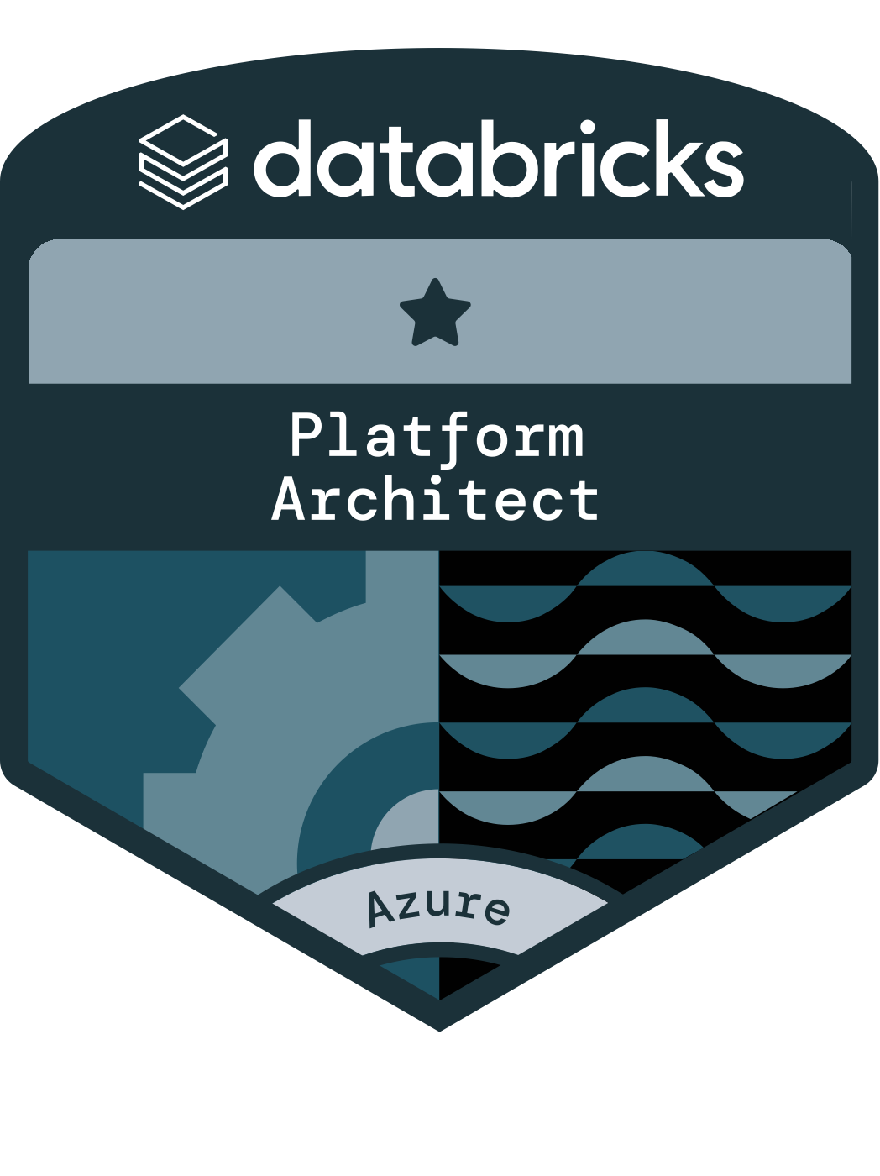
What certifications can I get after this class?
DP-100
Azure Data Engineer Associate
Azure Administrator Associate
Azure Solutions Architect Expert
Azure AI Fundamentals
Azure Data Scientist Associate
Azure Data Fundamentals
AZ-900
Azure Data Engineer Associate
DP-900
DP-203
AZ-305
AZ-104
AI-900
Azure AI Engineer Associate
AI-102
Databricks - Azure Platform Architect
Databricks - Apache Spark Developer Associate
Databricks - Fundamentals
https://learn.microsoft.com/en-us/credentials/browse/?products=azure
https://www.databricks.com/learn/training/certification

Slide 20
What are the exams like?
Written, use your own brain
Mix of multiple choice, true/false, short answer, “draw a diagram”
Defend your choices
Done in class

Slide 21
Lessons Learned
You have time in class to complete labs
I don't take attendance
Share cloud resources and help each other
Do your own work and turn it in on time

Slide 22
Budget - Everyone’s Responsibility
$6,000
$150/student
Do NOT spin up services outside of what I say in the labs.
Do apply for Azure for Students and the free Azure Credits.

Slide 23
Getting Started… Azure Setup, Installation of Required Software and more!

Slide 24
portal.azure.com

Slide 25
Next Week
Data Platform
We will be diving into using Azure Storage and Azure Synapse for the first lab assignment
Make sure you do your Intro Survey
You will be assigned to groups based on the results

